Slide 1

Applications of Learning Multiple Dynamical Systems: Joint Problems and Causal Modellings
Xiaoyu He (Serene)
Sep 25, 2025
Notes:
Good afternoon everyone. Welcome to my presentation. My name is Xiaoyu He, some of you may also know me as Serene. Today, I will present my thesis proposal on Applications of Learning Multiple Dynamical Systems, focusing on Joint Problems and Causal Modellings. Here you can find my thesis proposal by scanning this QR code or you can find the paper copy in front of you.

Slide 2
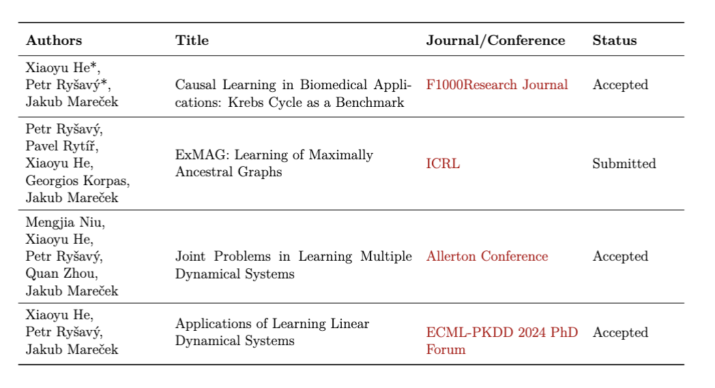
List of Publications
The asterisk (*) indicates equal contribution.
Notes:
Let’s begin with the list of my publications. So far, the first and third papers got accepted. The second one we just submitted to ICRL/eye-clear/ and the fourth one got accepted in the PhD Forum. For more information, please check the Chapter Contributions and Structure of my thesis proposal.

Slide 3
CONTENTS
01
Research Motivation
02
Benchmark Dataset
03
ExMAG: Causal Graph Learning
04
Joint Learning Problem
05
Contributions and Future Work
Notes:
In today’s presentation, I will first introduce the research motivation. Then I will present my three main papers: a new benchmark dataset, causal graph learning method ExMAG and application in joint learning problem. then, I will summarize the main contributions and future directions.

Slide 4
01
Research Motivation
Notes:
Let me start with the motivation behind this research.

Slide 5
Why Causal Discovery Matters
Understanding complex systems in biology and medicine requires more than correlation. We need to uncover the WHY behind dynamic processes.
The Challenge
The real-world biological dataset lost some universality, and the traditional methods fail to capture hidden confounders, limiting their ability to model complex real processes.
Notes:
In complex systems such as biology and medicine, it is not enough to capture correlations. What we really need is to uncover the causal mechanisms, which is the “why” behind dynamic processes.
However, the real-world biological dataset lost some universality, and the traditional methods fail to capture hidden confounders, limiting their ability to model complex real processes. This is why I researched these.

Slide 6
The Gaps Between Static and Real-World Systems
Static Systems
Real-World Systems
Assume static and acyclic structures
Require full observations
Cannot model feedback loops
Fail with hidden confounders
Rich in cyclic interactions
Have unmeasured variables
Exhibit dynamic feedback
Are full of confounders
These limitations lead to biased causal inferences and poor generalisations in dynamic environments.
Notes:
Before moving to Krebs cycle benchmark, let us think about the gaps between of Sta’tic systems and real-world systems:
The Sta’tic systems have strict limitations: such as
They assume static, acyclic structures.
They require full observations.
They fail to model feedback loops.
and , they break down when hidden confounders exist.
But the real-world systems face more challenges:
They are full of cyclic interactions.
They also contain many unobserved variables.
They exhibit/gz/ dynamic feedback.
And most importantly they always involve confounders.
As a result, old systems often lead to biased inferences and poor generalizations in dynamic environments.

Slide 7
02
Benchmark Dataset
Notes:
To address this, I propose a new benchmark: the Krebs cycle.

Slide 8
Acetyl CoA
Acetyl CoA
A New Standard:
The Krebs Cycle
Acetyl CoA
Citric acid
Citric acid
Citric acid
Cis-aconitate
H₂O
We propose the Krebs cycle as a realistic benchmark for evaluating causal discovery in dynamic systems. It moves beyond synthetic data to a complex, real-world process.
Oxaloacetate
Cis-aconitate
Oxaloacetate
H₂O
NADH
NADH
Oxaloacetate
Cis-aconitate
H₂O
NAD⁺
NADH
差不
NAD⁺
NAD⁺
Malate
Isocitric acid
Malate
Isocitric acid
Time-Series Data: More challenging than static data.
Malate
Isocitric acid
α-Ketoglutaric acid
NAD⁺
H₂O
Fumarate
NADH
NAD⁺
Inherent cyclic Interactions: A real-world biological process.
H₂O
α-Ketoglutaric acid
NADH
NAD⁺
Fumarate
α-Ketoglutaric acid
NADH
H₂O
Fumarate
Not R²-sortable: Not rely on any underlying framework.work
Succinate
Succinyl CoA
NAD⁺
NAD⁺
Succinate
Succinyl CoA
NADH
NAD⁺
Practical intervention: Increase the concentration of certain reactants and see how the other works.
FAD
Succinate
Succinyl CoA
NADH
NADH
FAD
H₂O
H₂O
H₂O
FAD
GTP
GDP
GDP
GDP
GTP
GTP
Notes:
Why the Krebs cycle?
1. First, it provides time-series data, which is much more challenging than static data.
2. Second, it is a real-world biological process with inherent cyclic interactions.
3. Third, our dataset is not R²-sortable, so our dataset more universal as it doesn’t rely on any underlying framework.
4. And forth, considering about the practicality, we allow to increase the concentration of certain reactants and see how the other works.

Slide 9
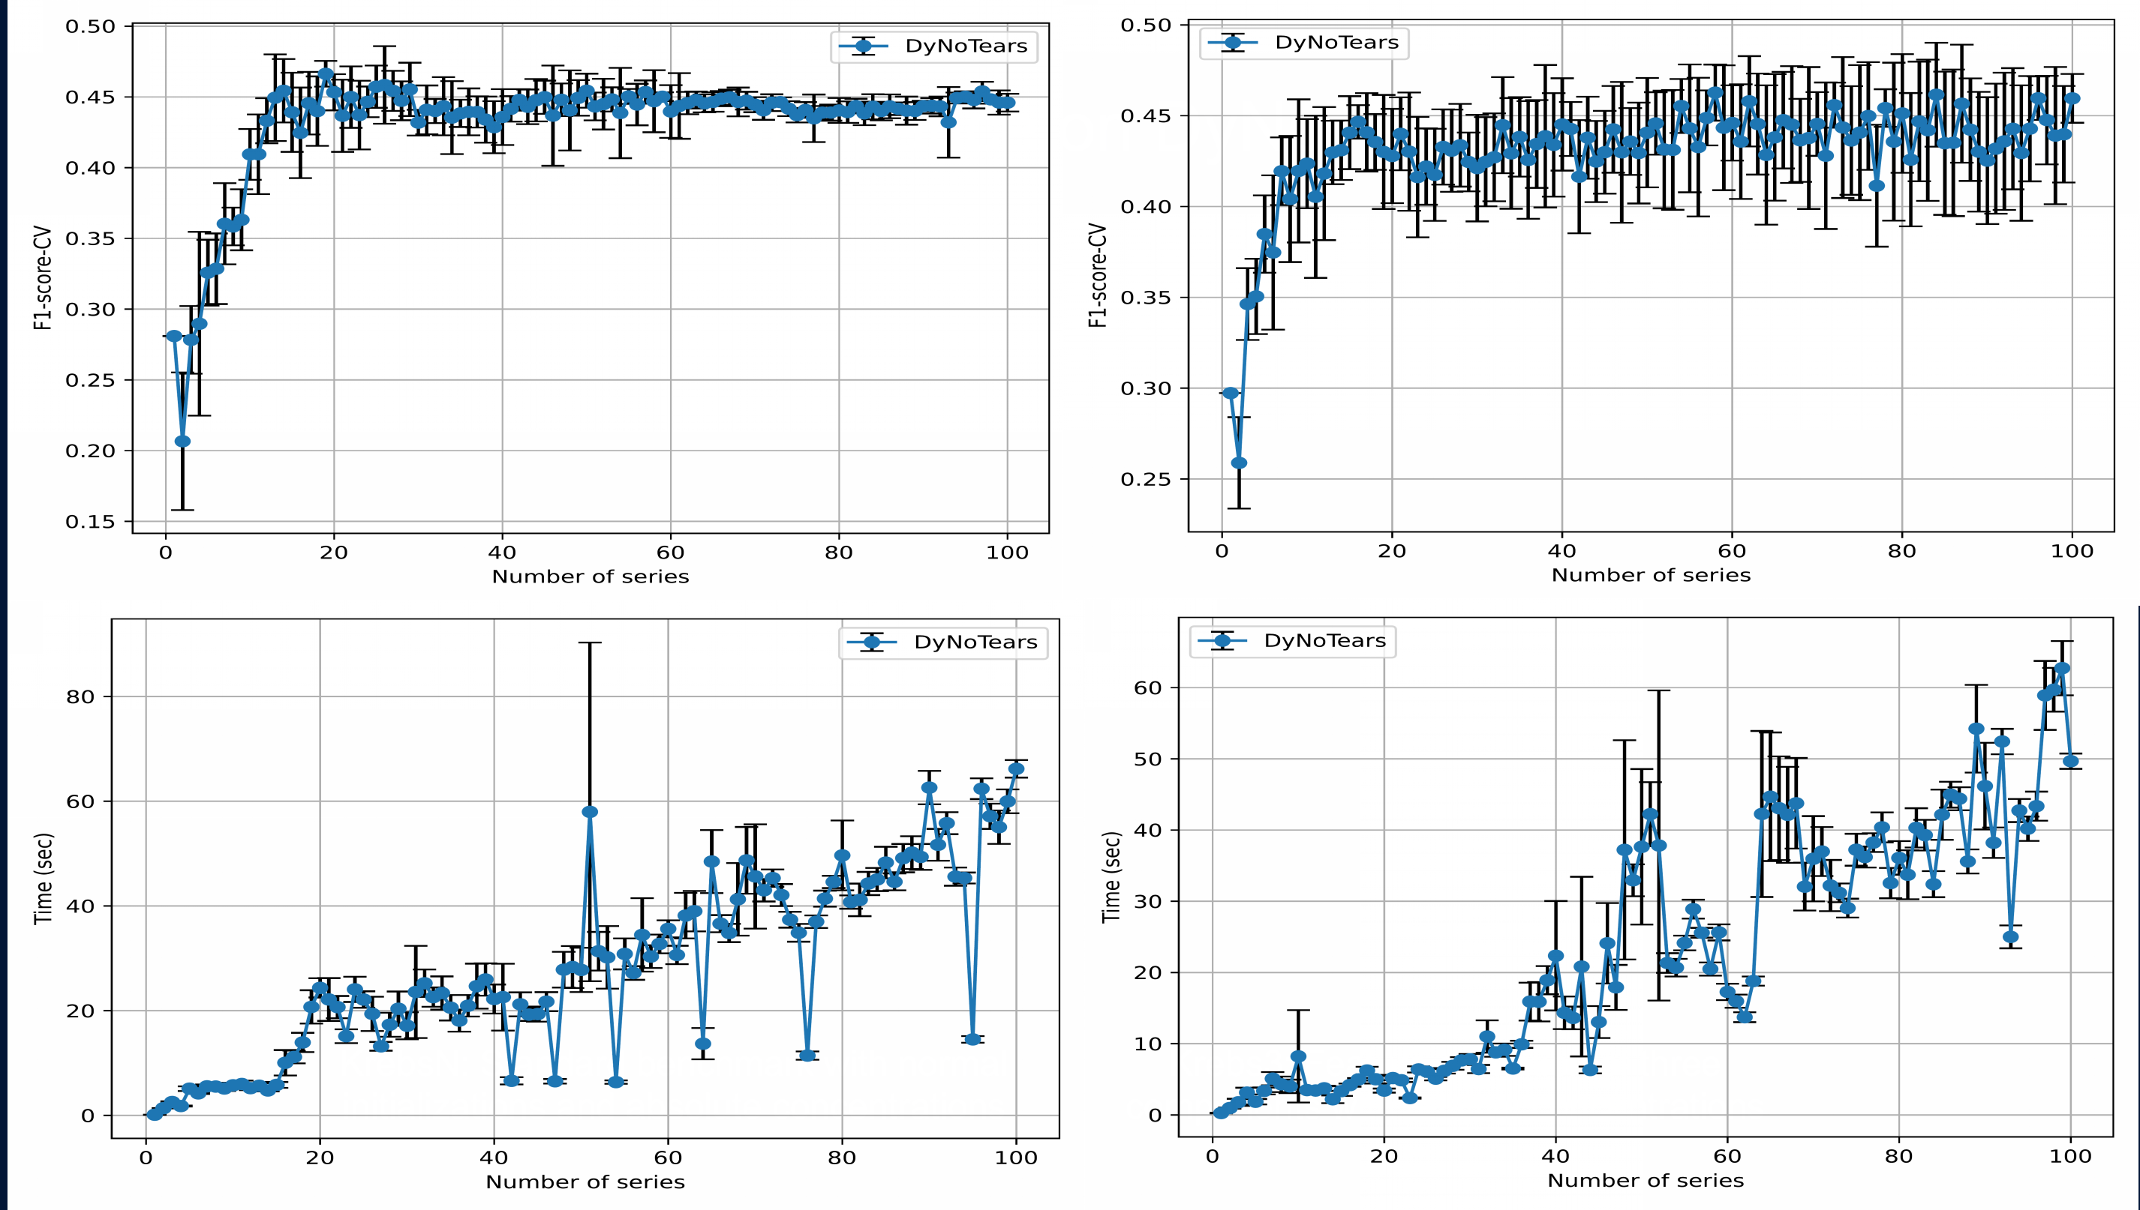
Performance of DyNoTears
Krebs3: Excites three components with relative concentrations
KrebsN: A standard benchmark with normal initialisations
Roxana Pamfil, Nisara Sriwattanaworachai, Shaan Desai, Philip Pilgerstorfer, Konstantinos Georgatzis, Paul Beaumont, and Bryon Aragam. DyNoTears: Structure learning from time-series data. In International Conference on Artificial Intelligence and Statistics, pages 1595–1605. Pmlr, 2020.
Notes:
Based on this, we designed two settings KrebsN and Krebs3:
KrebsN is a standard benchmark with normal initialization, and
Krebs3 excites three components with relative concentrations.
And then we can see the performance of DyNoTears on these datasets.

Slide 10
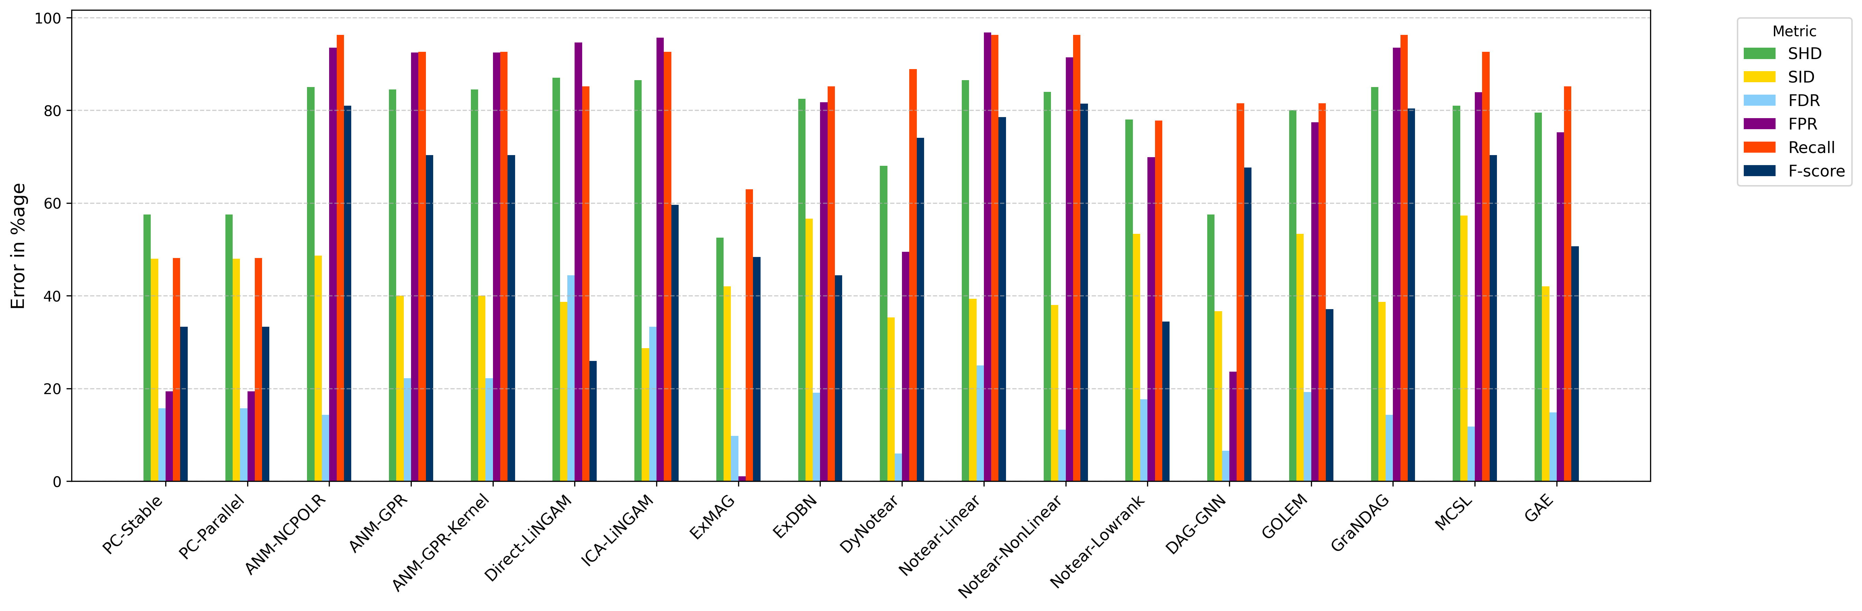
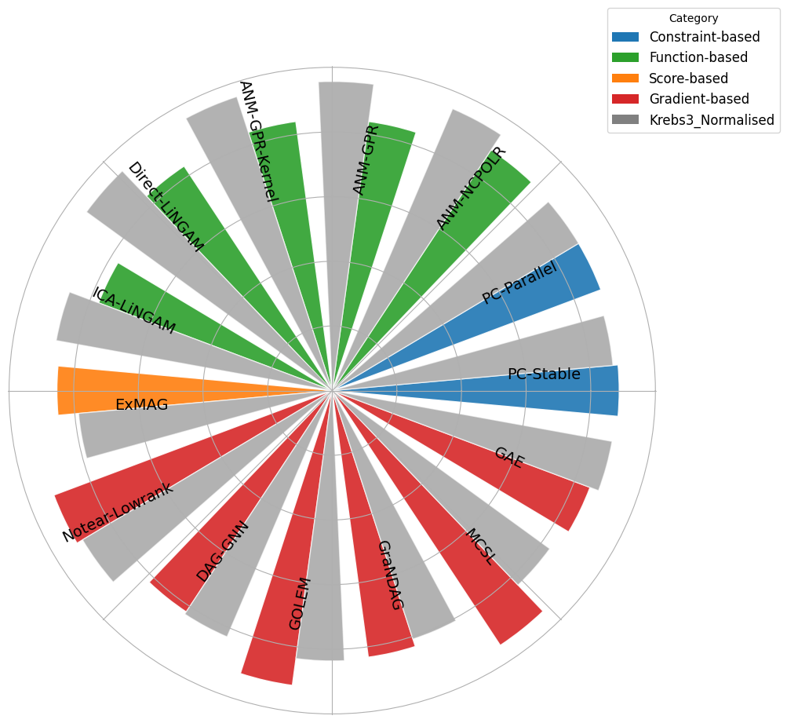
Comparisons Between Different Algorithms in Each Category
[Gcastle toolkit] Keli Zhang, Shengyu Zhu, Marcus Kalander, Ignavier Ng, Junjian Ye, Zhitang Chen, and Lujia Pan. gcastle: A python toolbox for causal discovery. arXiv preprint arXiv:2111.15155, 2021.
Notes:
Besides DyNoTears, we also compared our methods, ExDBN and ExMAG, with more than 20 approaches from the GCastle toolkit. As shown, our methods demonstrate outstanding performance compared to other causal discovery approaches. In addition, SID scores for different algorithms in each category are shown on the right. We also include results of the normalized dataset, indicated by the grey overlay/ei/.
For more details about methods, please refer to the gCastle toolkit.

Slide 11
03
ExMAG: Causal Graph Learning
Notes:
Now let us move to the second part of my work.

Slide 12
ExMAG: Seeing the Unseen
In the paper, we formulize the Causal Graph Learning problem as a Mixed Integer Quadratic Programing (MIQP) problem. The cost function is the following
L_{q} norm:
where:
Y_{i,m} represents the value of the m-th variable for the i-th data point;
w_{j,m} represents the weight of the edge from variable m to variable j;
e_{j,m} is the binary decision variable indicating a directed edge j → m;
b_{j,m} is the binary decision variable indicating a bidirected edge j ↔ m;
λ ∈ ℝ⁺ is a regularisation parameter;
The exponent q ∈ℕ can take values q = 1 or q = 2.
ExMAG learns Maximal Ancestral Graphs (MAGs), which extend DAGs to model hidden variables and bidirected edges for confounding effects.
Accurate discovery with unobserved confounders.
Improves robustness in real-world applications.
Provides a more expressive causal representation.
Notes:
This part introduces a Seeing the Unseen method — ExMAG. Why do we call it Seeing the Unseen?
Because MAGs extend traditional DAGs to model hidden variables and bidirected edges for confounding effects.
The advantages of ExMAG are clear:
1. It can discover causal structures even with unobserved confounders.
2. It improves robustness in real-world applications.
3. And it provides a more expressive causal representation.
In the paper, we formulize the Causal Graph Learning problem as a Mixed Integer Quadratic Programing (MIQP) problem as we shown here.

Slide 13
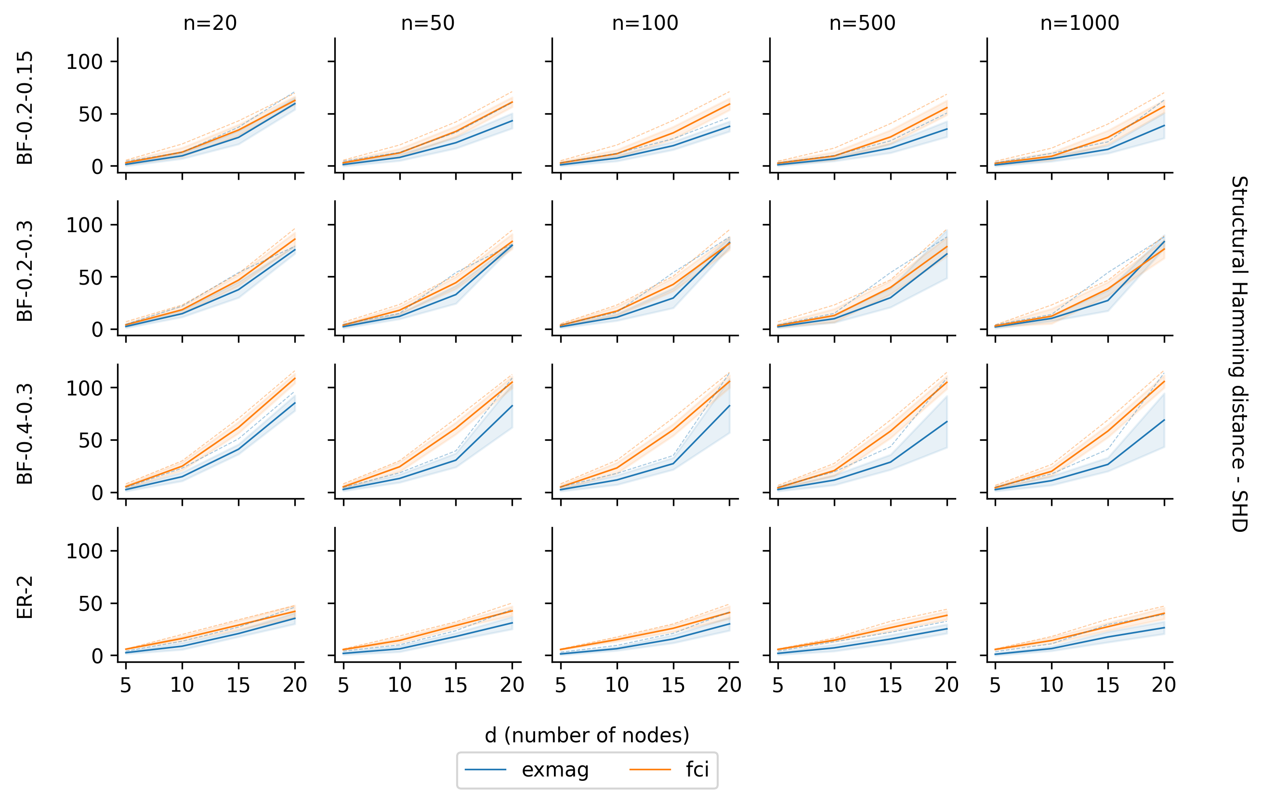
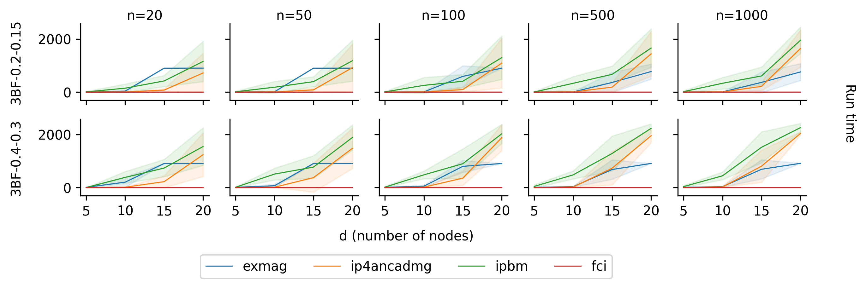
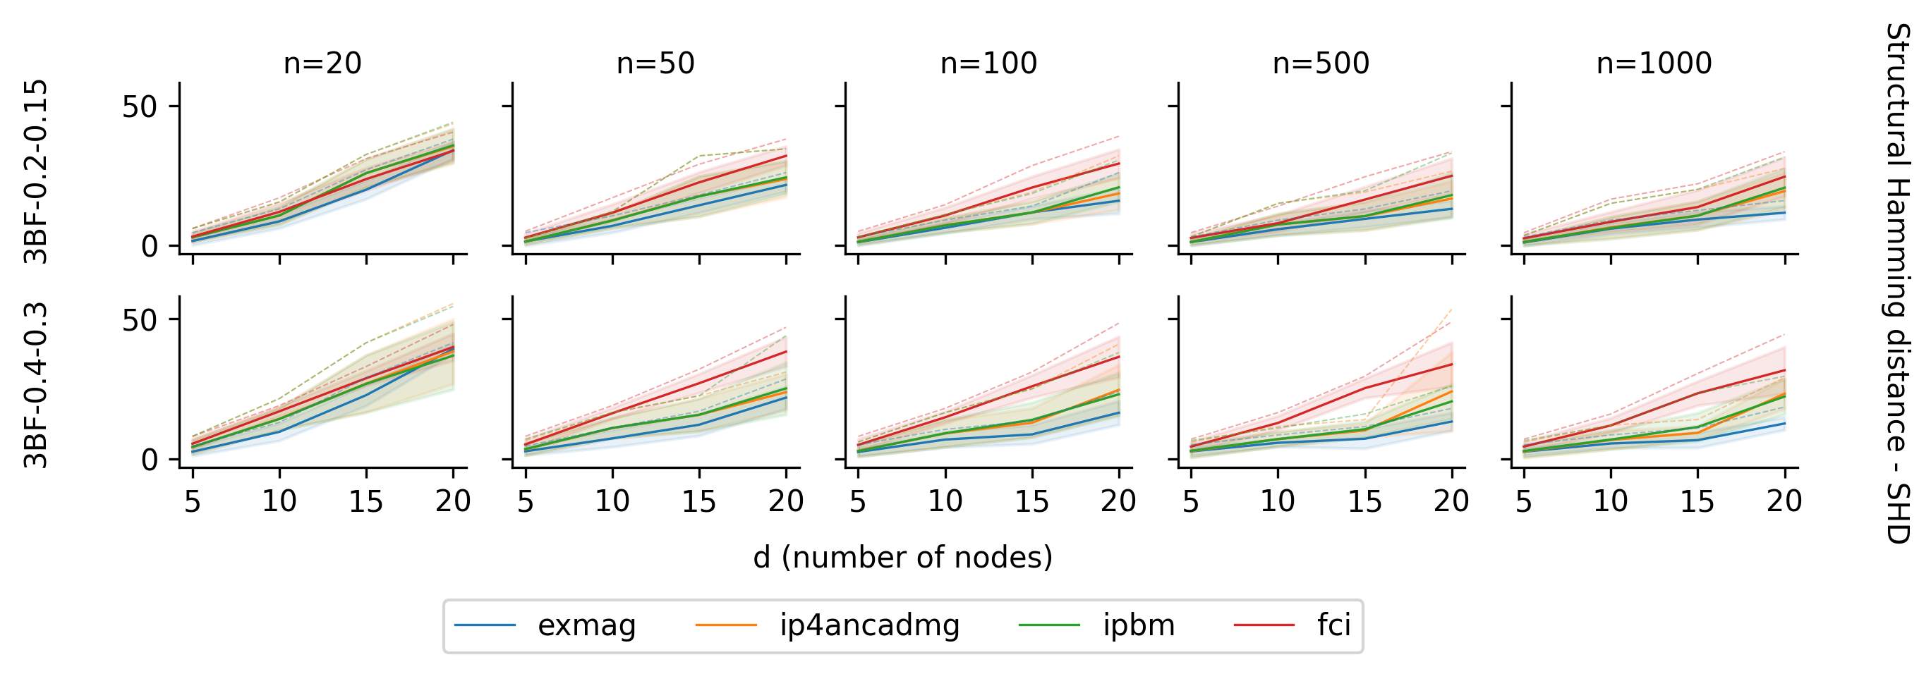
ExMAG Performance
Comparisons Between ExMAG and FCI Algorithms
Comparisons Between ExMAG, IP4AncADMG, PBMs and FCI
SHD values for different settings of graph
Runtime and SHD values
[IP4AncADMG] Rui Chen, Sanjeeb Dash, and Tian Gao. Integer programming for causal structure learning in the presence of latent variables. In International Conference on Machine Learning, pages 1550–1560. PMLR, 2021.
[PBMs] Sanjeeb Dash, Joao Goncalves, and Tian Gao. Integer programming based methods and heuristics for causal graph learning. In The 28th International Conference on Artificial Intelligence and Statistics, 2025.
[FCI] Peter Spirtes, Christopher Meek, and Thomas Richardson. Causal inference in the presence of latent variables and selection bias. In Proceedings of the Eleventh Conference on Uncertainty in Artificial Intelligence, UAI’95, pages 499–506, San Francisco, CA, USA, August 1995. Morgan Kaufmann Publishers Inc. ISBN 978-1-55860-385-1.
Notes:
In experiments, ExMAG outperforms in both runtime and accuracy comparing with classic integer-programming-based approaches.

Slide 14
04
Joint Learning Problem
Notes:
The third contribution is about joint learning complex Dynamical Systems.

Slide 15
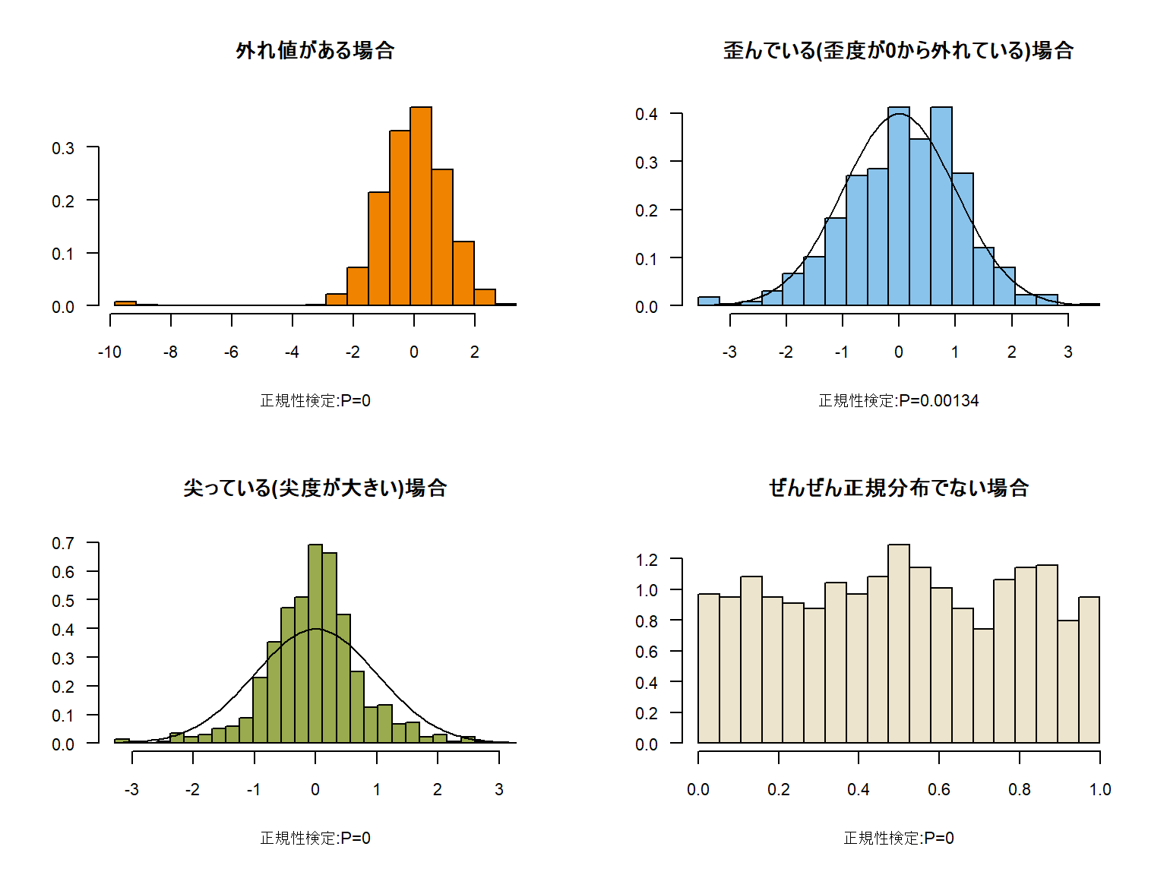



Joint Learning of Complex Dynamical Systems
We address the joint problem of clustering time-series trajectories and learning a Linear Dynamical System (LDS) for each cluster. This enables the discovery of shared latent structures and cross-system dependencies, improving statistical efficiency.
$$\overset{→}{X_{t}^{1}}$$
L1
...
$$\overset{→}{X_{t}^{2}}$$
L2
$$\overset{→}{X_{t}^{M}}$$
...
S
T
Hidden State
Observation State
EM Heuristic Process
Notes:
We address the joint problem of clustering time-series trajectories and learning a Linear Dynamical System (LDS) for each cluster. Here is the demonstration of process.

Slide 16




The NCPOP Framework
The Non-Commutative Polynomial Optimization (NCPOP) framework offers the theoretical foundation for formulating the joint clustering problem as LDSs with latent variables.
A single realisation of the LDS with length T, denoted Y={ y_{1,}y₂ , ... , y_{T} } ∈ℝ^{M×S×T} is defined by initial conditions X₀ and system matrices G and F as
where:
N is the hidden state dimension and M is the observational dimension.
X_{t} ∈ ℝ^{m×s} is the vector autoregressive processes with hidden components.
The transpose of F is denoted as F’.
Vector Y_{t} ∈ ℝ^{n×s} is the observed output of the system.
Operator-Valued
Variables are operators in an unknown dimension.
Global Optima
Finds the best solution without local minima traps.
Convergence Guarantees
Theoretical assurance of finding the optimal solution.
Notes:
In the paper we gave a single realisation of the LDS with T length and The NCPOP framework offers the theoretical foundation for formulating the joint clustering problem as LDSs with latent variables.
There are loads advancements of NCPOP. Notably, NCPOP does not assume the dimension of the hidden states in advance.

Slide 17
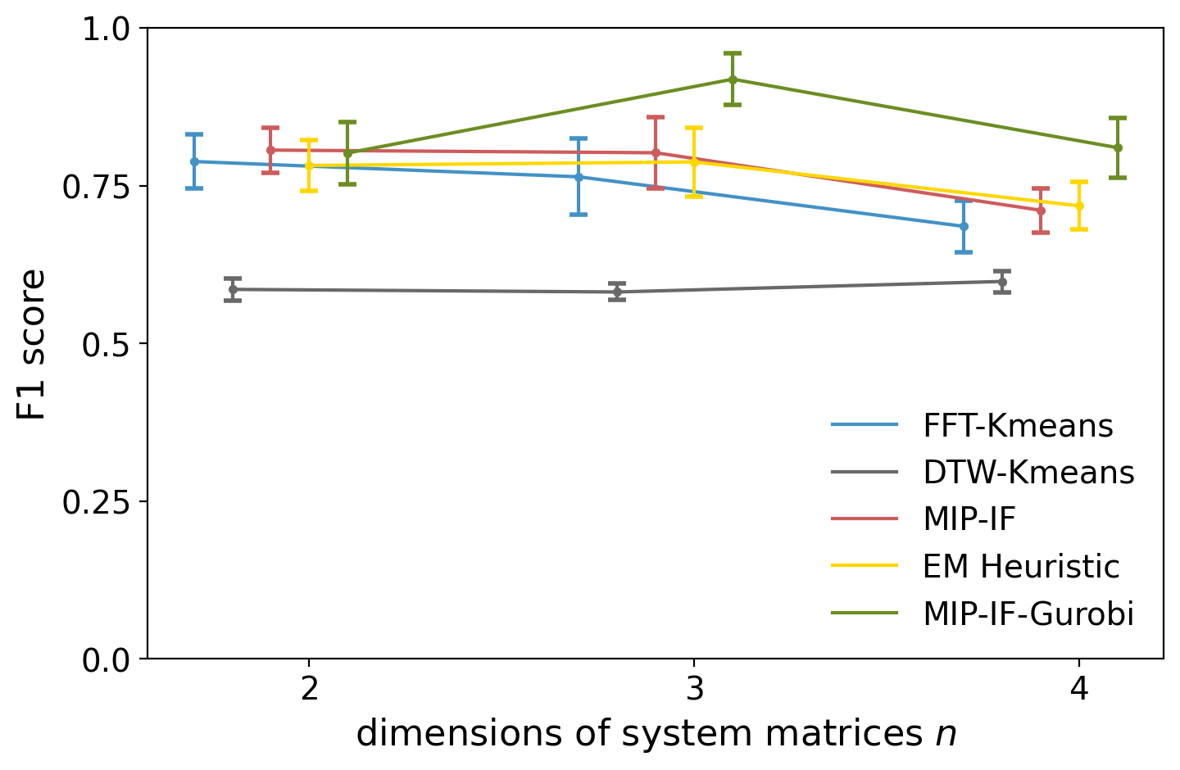
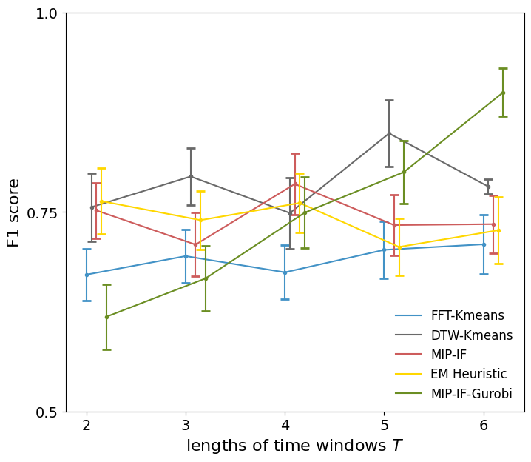
Performance of EM Heuristic
Superior Clustering Accuracy
Robustness to Window Size
The EM heuristic achieves high F1-scores on synthetic and real-world ECG data, outperforming baselines.
Performance remains stable even with shorter time windows, unlike other methods.
Notes:
Now, let us examine the performance on synthetic data and real-world ECG data. As shown here, our method achieves higher clustering accuracy and remains robust across different time window lengths.

Slide 18
05
Contributions and Future Work

Slide 19
Main Contributions
1. A Motivating Benchmark
A realistic Krebs cycle benchmark to evaluate dynamic causal discovery.
2. The ExMAG Algorithm
3. Joint Framework
A novel method for learning causal graphs with latent confounders.
A method to cluster and learn multiple interacting dynamical systems.
It contributes to three real-world challenges in causal inference: temporality, confounding and joint clustering.
Notes:
To summarize, the main contributions of this work are threefold. my research leverages the Krebs cycle as a motivating benchmark, introduces ExMAG as an efficient algorithm for learning confounders, and extends the framework to joint problems for learning multiple dynamical systems.

Slide 20
From Theory to Real-World Impact
Biomedicine
Metabolomics
Genetic Epidemiology
Mimic disease progression and assess the effects of dietary interventions.
Model concentrations of metabolites and build in recommender system of nutrition informed by the causal models
Incorporating latent variable can detect confounders in GWAS.
Notes:
On the practical side, these methods can be applied to biomedicine, Metabolomics and genetic epidemiology.
1. In biomedicine, we can model disease/zi/ progression and assess the effects of dietary interventions.
2. In Metabo’lomics/table/, we model concentrations of me’tabolites obtained using nuclear magnetic resonance (NMR) analyses of serum and urine, and build in recommender system of nutrition informed by the causal models.
3. In genetic epidemiology, incorporating latent variable models can detect confounders such as population structure and environmental exposures in GWAS genome-wide association studies.

Slide 21
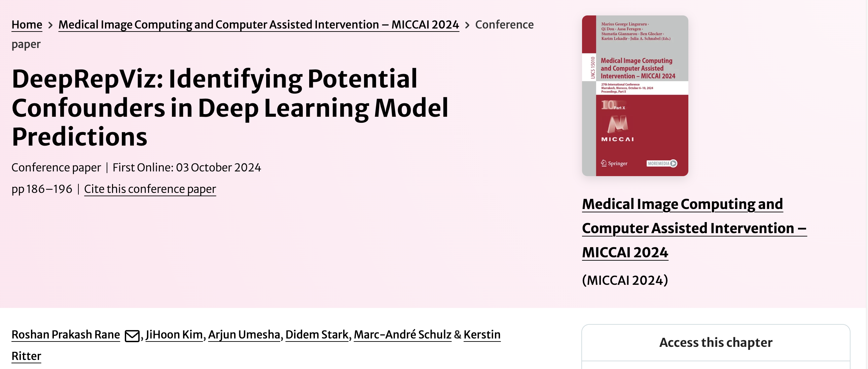
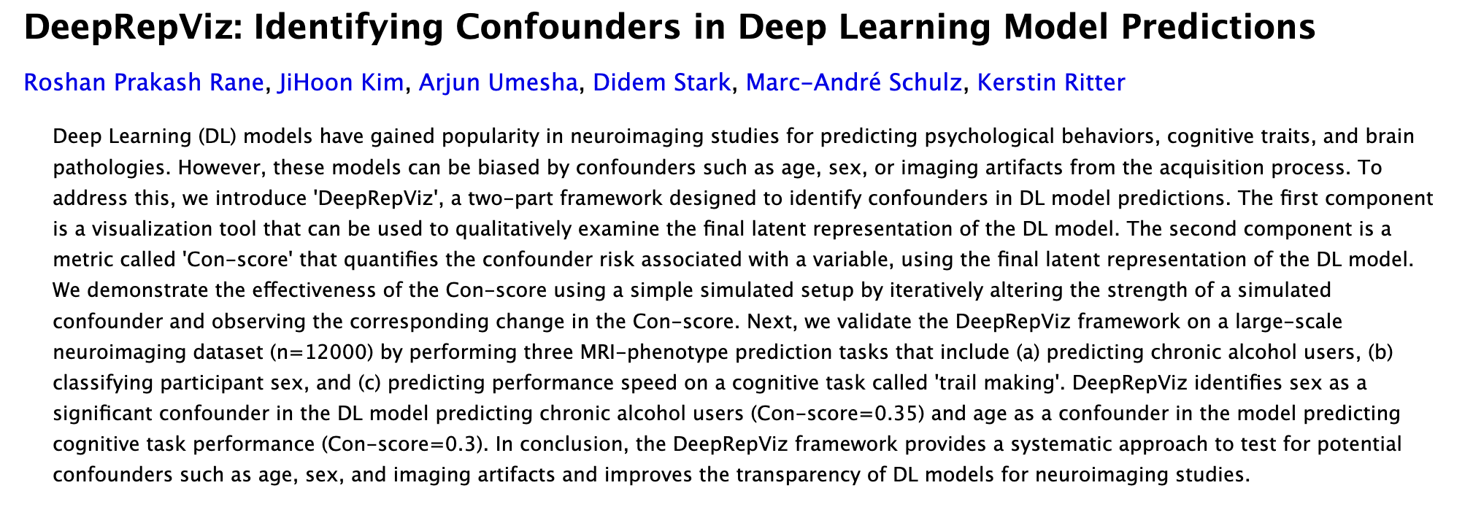
Future Work:
Constraining the MAGs: Consider structural complexity measures such as clique-width or treewidth.
Identifiability of Causal Models: Motivated by continuous-time bilinear dynamical systems (BDS), with a particular focus on tree-structured causal models.
Integration with Deep Learning: Apply constrained training of DNNs to CoDiet datasets combined with GBD health reports.
Solving these problems would take causal inference closer to adaptive and interactive real-world systems.
Notes:
Looking ahead, there are several promising directions.
1.Constraining the MAGs under consider with some measure of structural MAG complexity, such as clique-width or treewidth.
2.The next promising research is Identifiability of causal models, especially for tree-structured causal models.
3.We are applying constrained training of DNNs to CoDiet datasets combined with GBD health reports.
I believe solving these problems would take causal inference closer to adaptive and interactive real-world systems.

Slide 22
THANK YOU!
Artificial Intelligence Center Faculty of Electrical Engineering Czech Technical University in Prague

